Slide 1

PROBLEM STATEMENT
Cricket is undoubtedly the most loved sports in India. Even Blind people have been playing Cricket from many years . Our Project aims at taking Blind cricket to next level by introducing few advancements using Image Processing and its tools . The main aim is making the game more interesting while keeping in mind that the technology don’t damage the spirit of blind cricket which is solely based on the hearing power of the blind cricketers.

Slide 2


KEY POINTS FOR OUR PROJECT
Ball Detection
Distance Calculation
Ball Tracking
Direction Assistance
Text to Speech
Hardware implementation

Slide 3
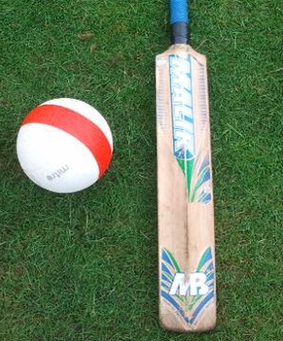
Current Rules
There are a total number of 11 players in each team: at least four players who are totally blind (classified as B1) and three partially blind players (B2), and up to four partially sighted players (B3).
The bowler must shout 'Play!' as he releases the ball. The delivery is required to pitch at least twice when bowled to a completely blind batsman (once when bowled to a partially sighted batsman) but must not be rolling.

Slide 4
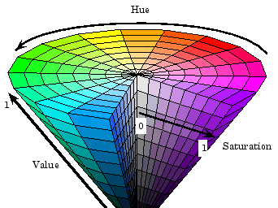
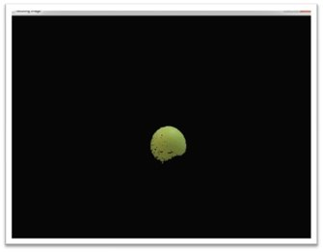
Ball Detection
Ball detection is done on the basis of its color as this is the basic technique of the open CV in this technique, we used the HSV COLOR of the ball to extract that color from the frame and then using the bitwise operator and background subtraction we separate that color from the frame here we will get that ball separately from the frame.

Slide 5
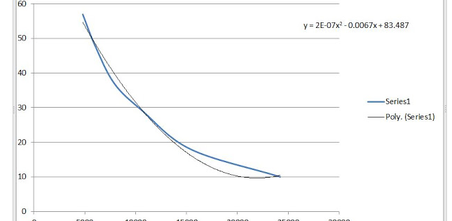
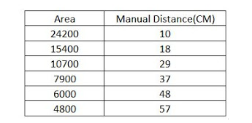
Distance Calculation For Fielders
This simply means that, if your object is near to the camera, the object will appear bigger. Thus the pixel area occupied by the object will be very large. As you move the object farther from the camera, the object size in the image will start to diminish. And hence the pixel area enclosed by the object will become smaller and smaller.

Slide 6
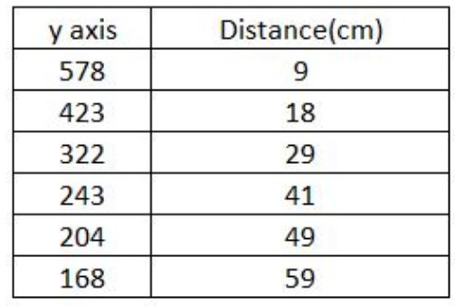
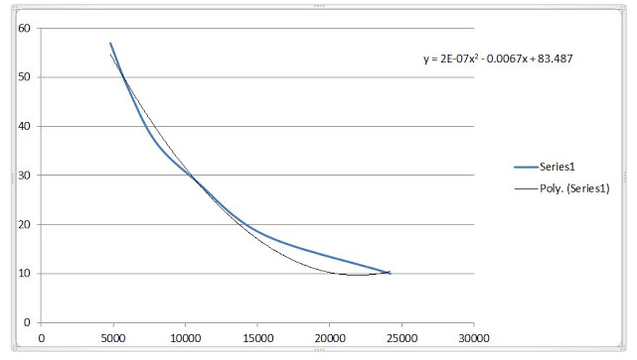
Distance Calculation For Batsman
Principle:- As the object moves farther away from the camera, the Y-axis coordinate decreases. This simply means that, if your object is near to the camera, the Y-axis coordinate will be very large. As you move the object farther from the camera, the object will appear to move above in the image and thus decreasing the Y-axis coordinates proportionately.

Slide 7
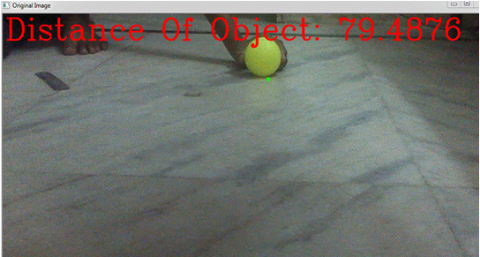
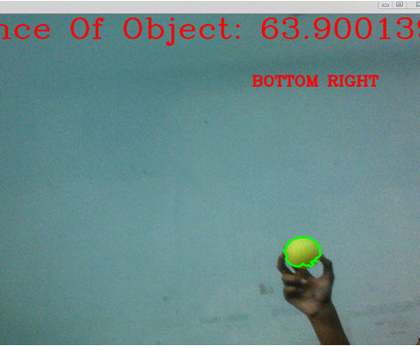
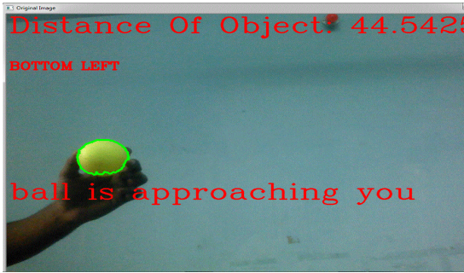
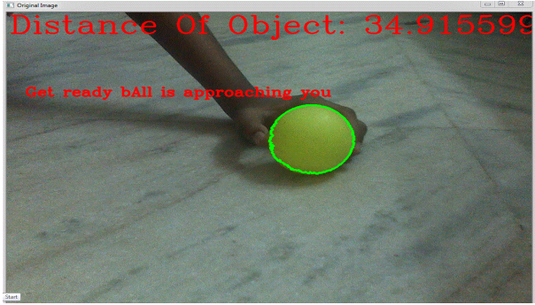

Slide 8
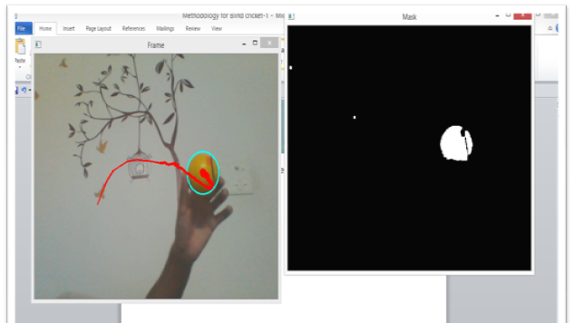
Ball Tracking

Slide 9


Direction Assistant
Direction Assistant is done with the help of the frame coordinate in which the frame is divided into four parts and then the direction off ball is identified and will be told to the fielder if the ball is approaching in the fielder's range

Slide 10
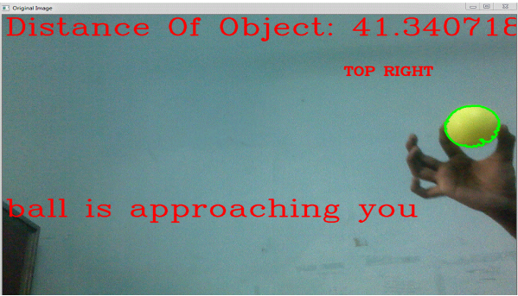
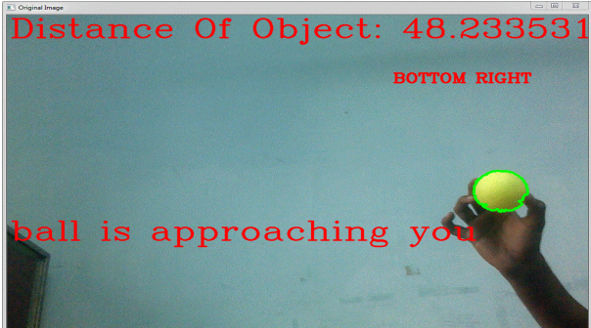
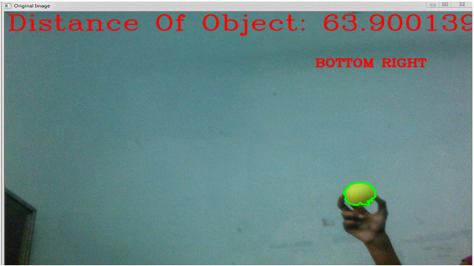
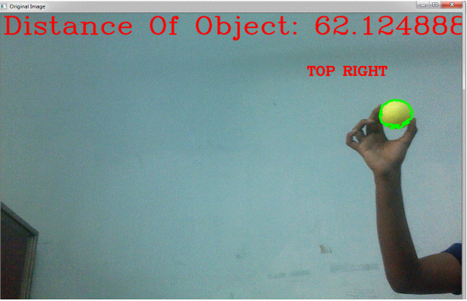
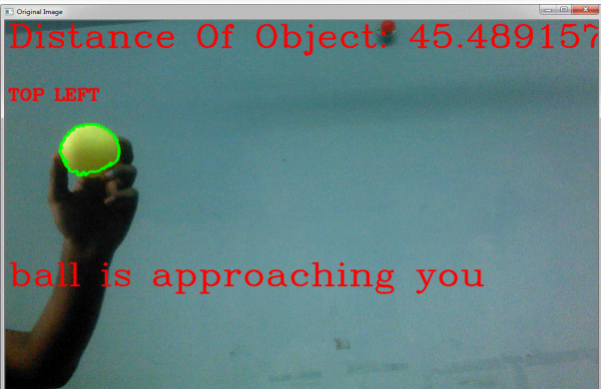
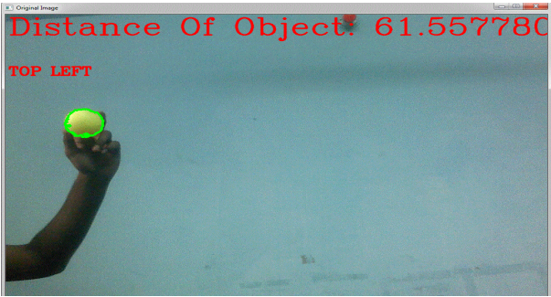

Slide 11
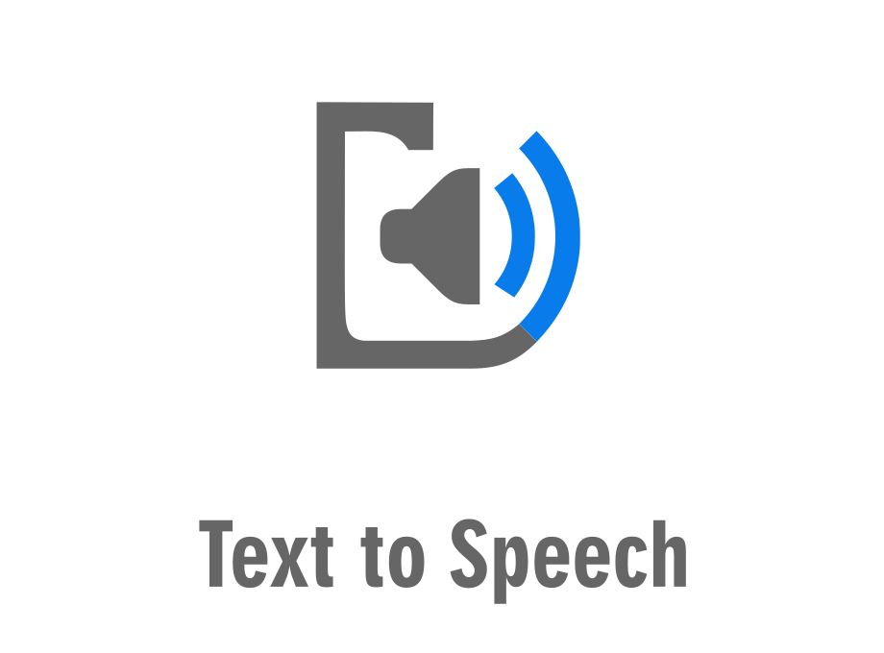
Text to Speech
In this project we have made use of gTTS, a Python library and CLI tool to interface with Google Translate's text-to-speech API.
Customizable speech-specific sentence tokenizer that allows for unlimited lengths of text to be read, all while keeping proper intonation, abbreviations, decimals and more;
Customizable text pre-processors which can, for example, provide pronunciation corrections;

Slide 12
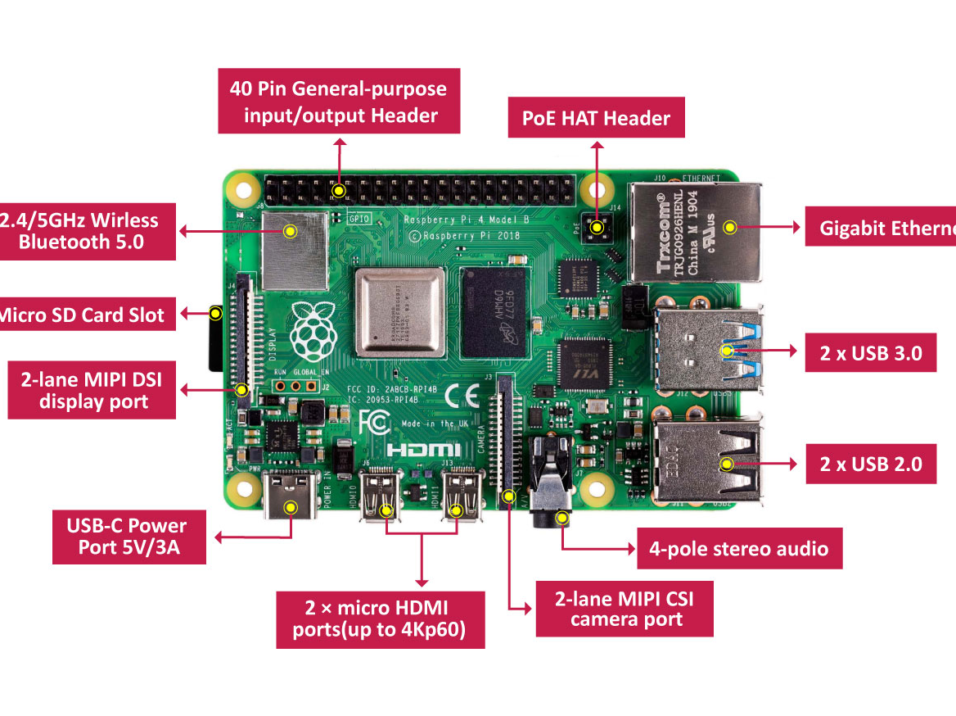
Hardware
A Raspberry Pi board with Raspbian OS.
A web camera.
SD Card
Bluetooth
Earphones

Slide 13

Software
The code was made in Python with the following libraries included:
OpenCV
gTTS
Numpy
OS

Slide 14

Future Scope
Instead of “play” call called by the bowler while releasing the ball we will give a beep sound into the ears of the batsman through earphones. So that bowler can concentrate on the delivery rather than “no ball” that will be called if you do not say “play”. This can be done with the help of Distance calculation method used for Batsman.
Knowing the field position is very important for the batsman before facing any delivery, so by using the present technique of detecting the positions of the Fielders we can alert the batsman by converting that information into sound by using Text to Speech algorithm.
We will now give the direction to the fielder in which the ball is coming so if he want to dive to stop the ball he will dive in that direction only in which the ball is coming he will not dive unnecessary in opposite direction which can lead to the injury
We are giving the beep sound to the batsman in between so that we will able to make the choice of shot selection on the basis of sound of ball bearing of the ball which he will hear

Slide 15
THANK YOU!

